Slide 1
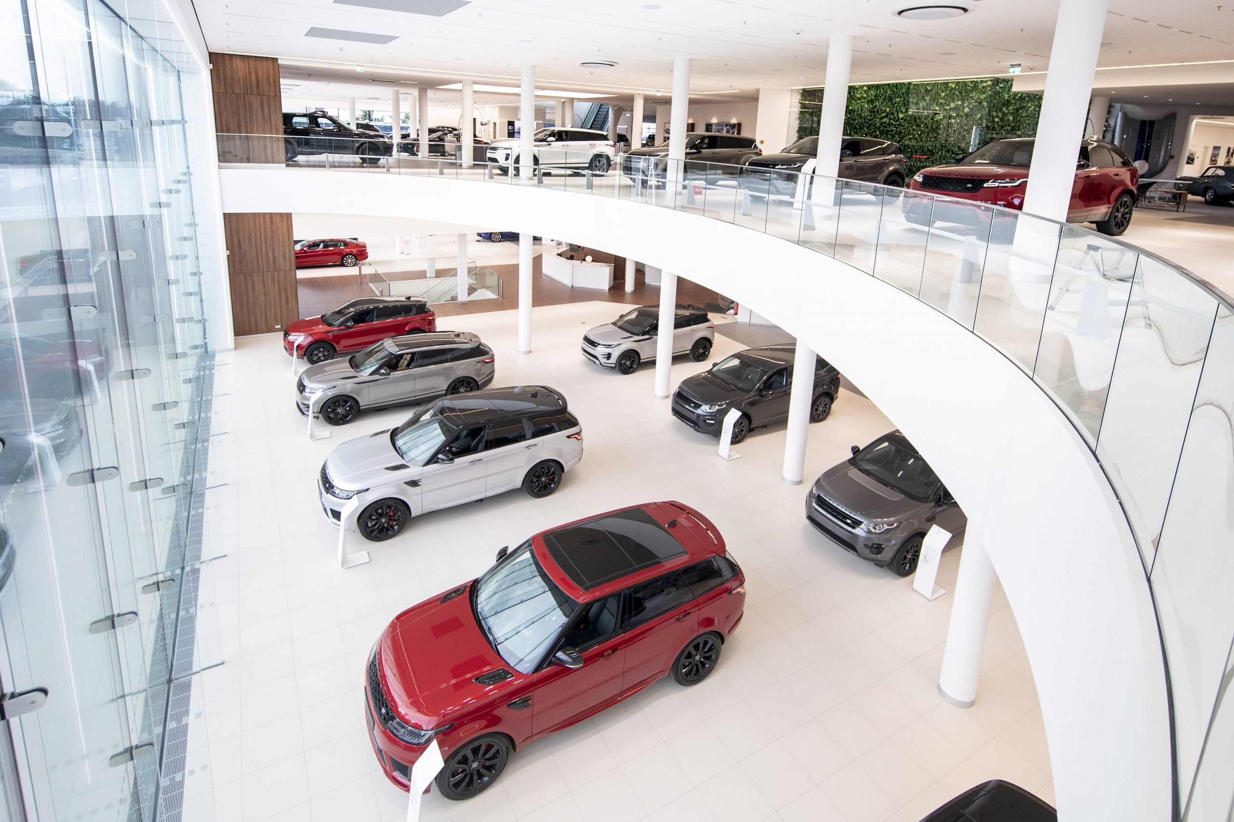
SQL DATA CHALLENGE 1
Steve’s car showroom

Slide 2
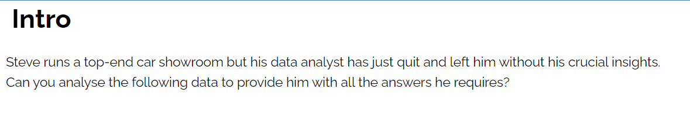

Slide 3
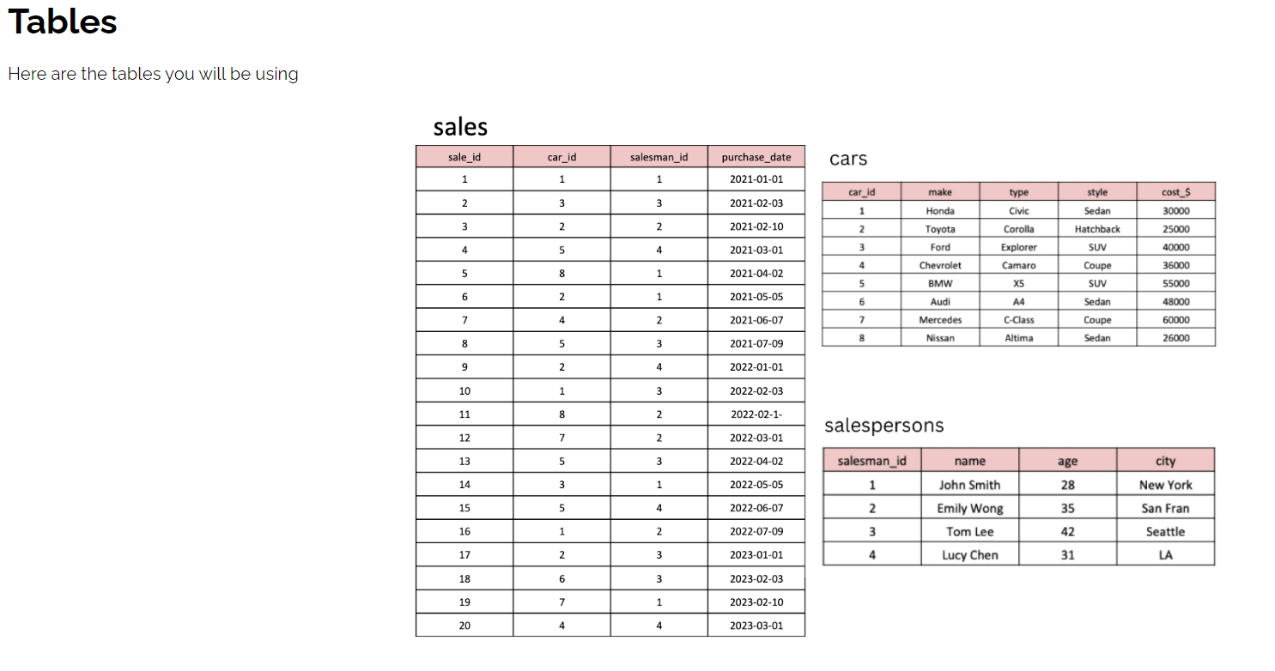

Slide 4
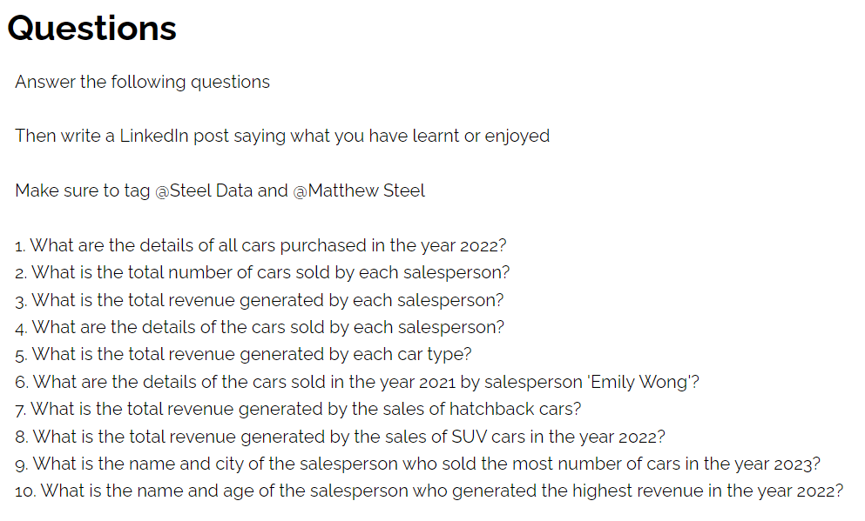

Slide 5
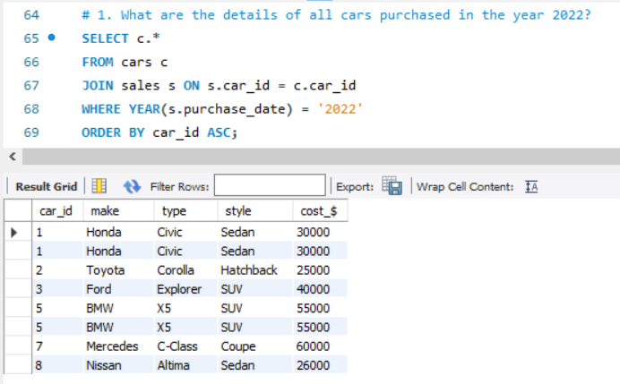

Slide 6
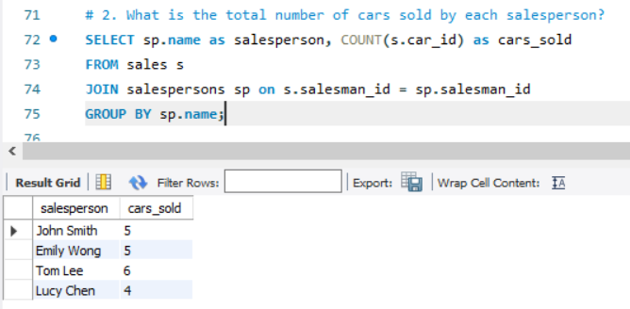

Slide 7
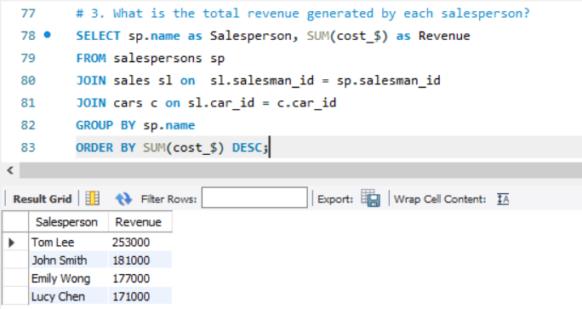

Slide 8
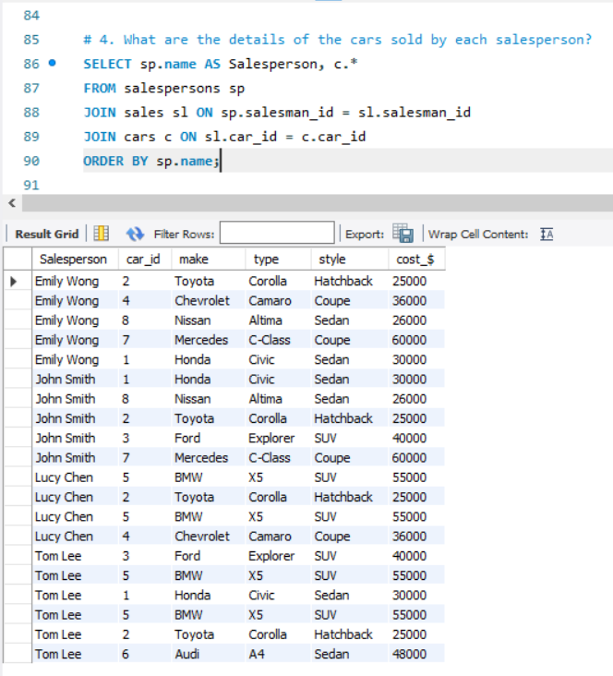

Slide 9
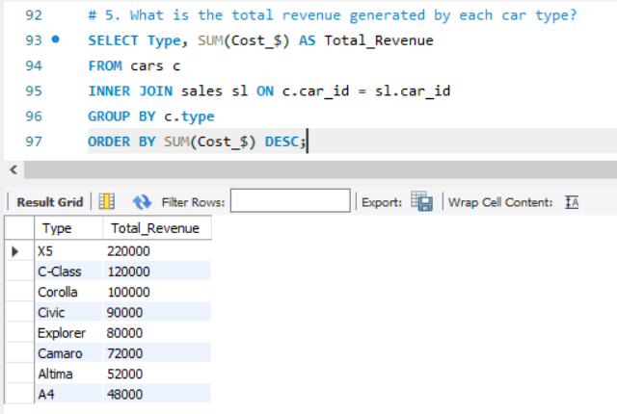

Slide 10
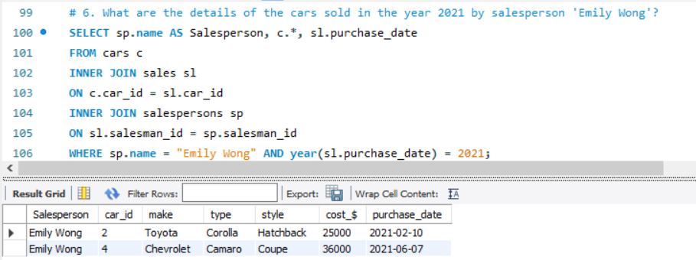

Slide 11
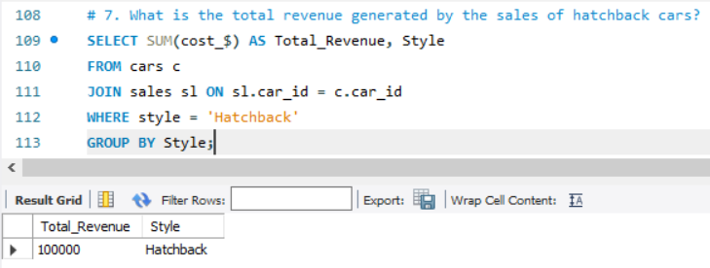

Slide 12
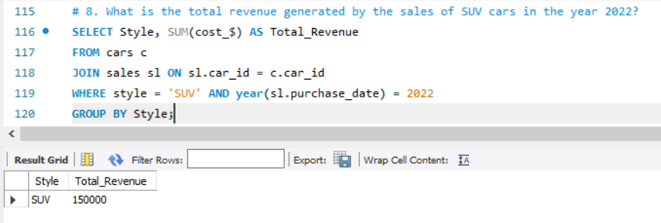

Slide 13
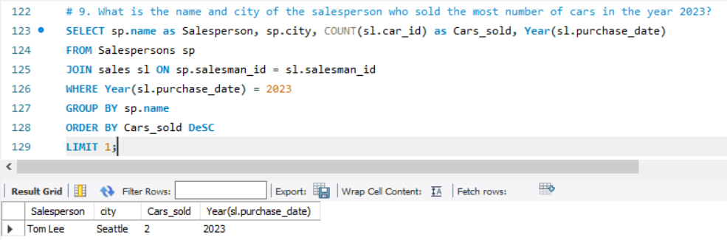

Slide 14
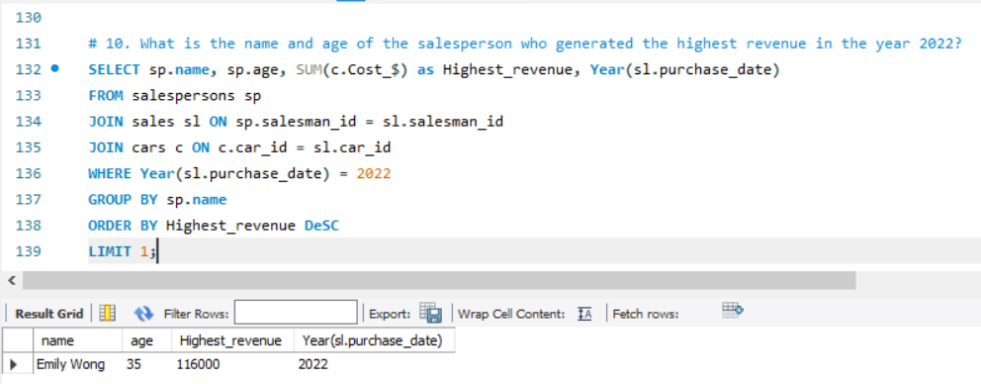

Slide 15
Insights
John Smith and Emily Wong were the salespeople who sold most cars with 5 cars each.
Tom Lee was the seller who generated the highest revenue along the 3 years.
The car model X5 (BMW) was the one which accrued the top revenue out of all the models.
The Hatchback model (Toyota) sold 150000.

